Slide 1
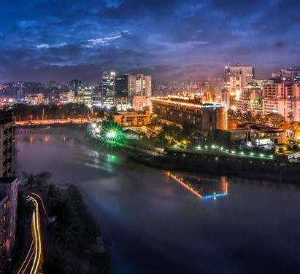
Clustering Venues of Dhaka
Capstone project for IBM Data Science
By Abidur Rahman

Slide 2
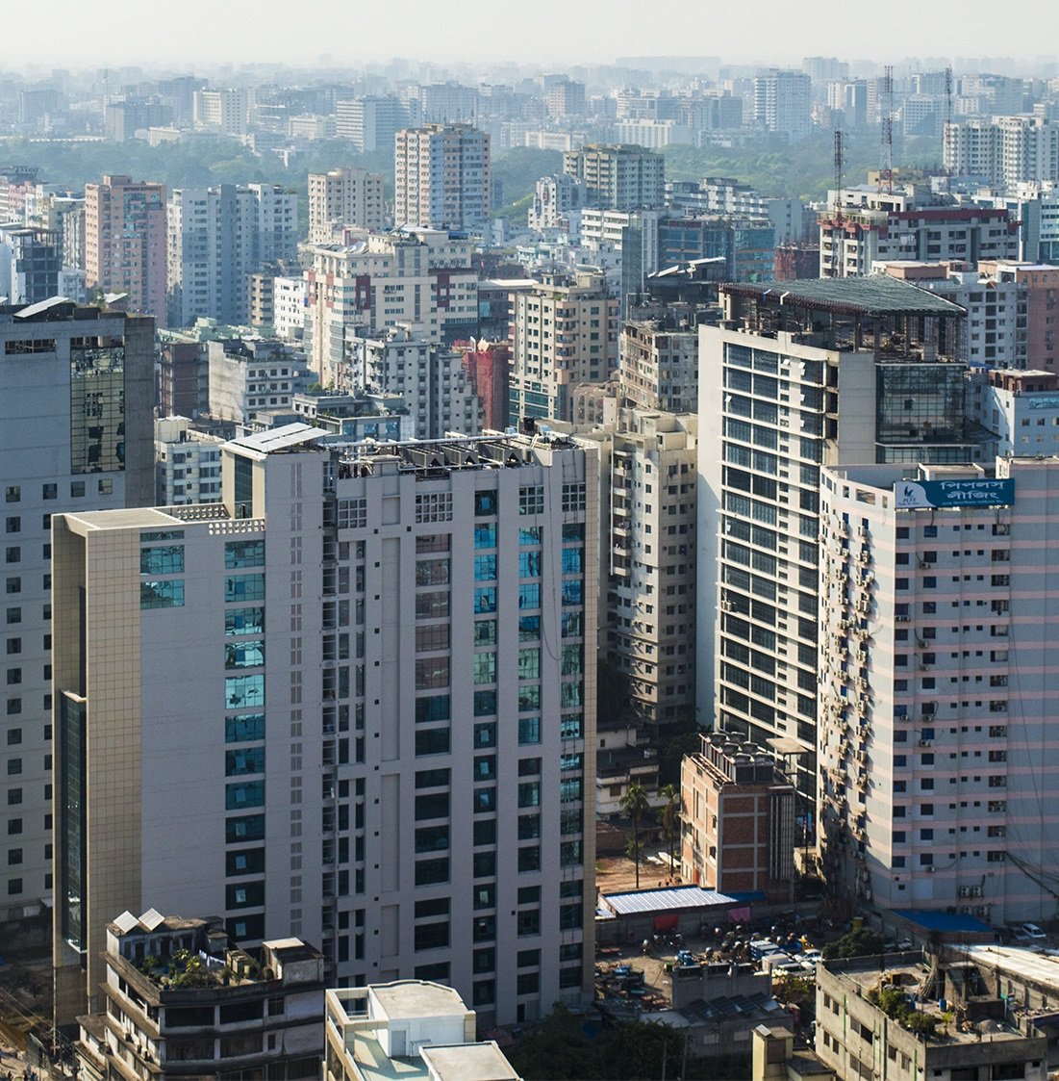
Dhaka City
Dhaka is the capital and the largest city of Bangladesh. It is the ninth-largest, and the sixth-most densely populated city in the world, with a population over 21 million in the Greater Dhaka Area. It is the largest city in Eastern South Asia.

Slide 3


This clustering will help us figure out the pattern in different areas, which can later help to determine the types of businesses to be opened there. This analysis will be important to any entrepreneur who wants to open a new business and needs to know which location would be the best.
Problem
Despite being a large city, a metropolitan, there is not enough data or data analysis about Dhaka, especially about the different venues in Dhaka. However, to start a new business, it is very important to have adequate data, refined data about the neighborhood. So an analysis of the type of venues in an area, and the competition level, turn out to be very important.
Interest

Slide 4
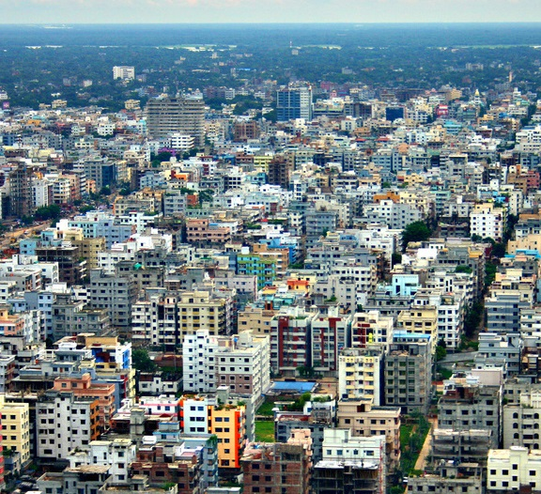
Source of data
Google Maps
for finding nearby venues and some details about them
Wikipedia
details about different areas of Dhaka
Foursquare API
common venues of Dhaka with location and other details

Slide 5
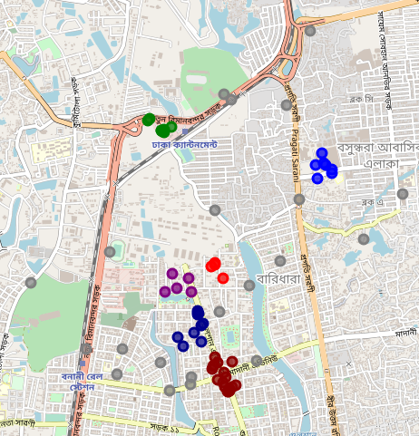
Map of the clusters

Slide 6
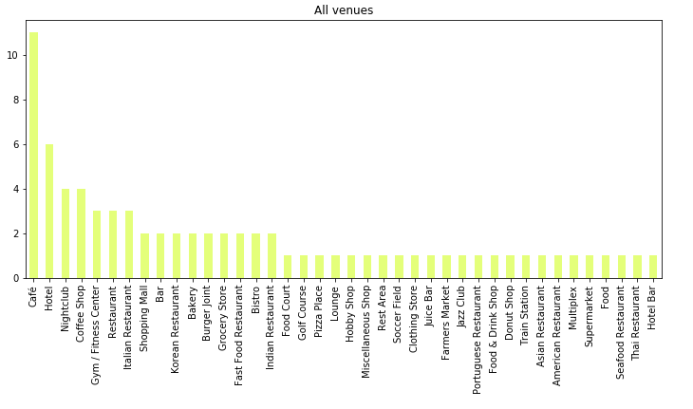
Category distribution for all venues

Slide 7
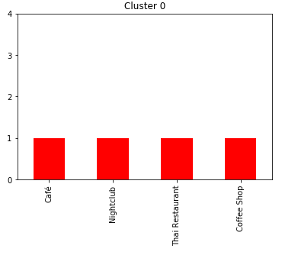
Category distribution for Cluster 0

Slide 8
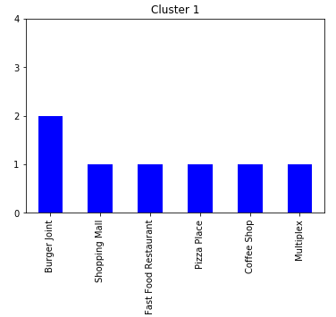
Category distribution for Cluster 1

Slide 9
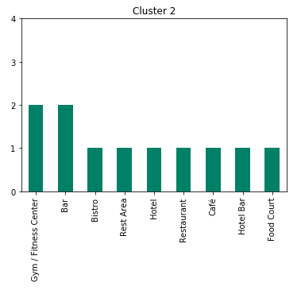
Category distribution for Cluster 2

Slide 10
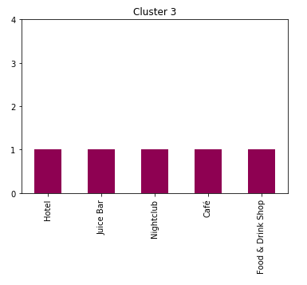
Category distribution for Cluster 3

Slide 11
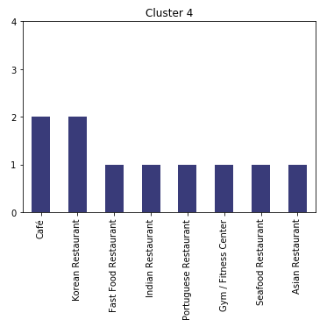
Category distribution for Cluster 4

Slide 12
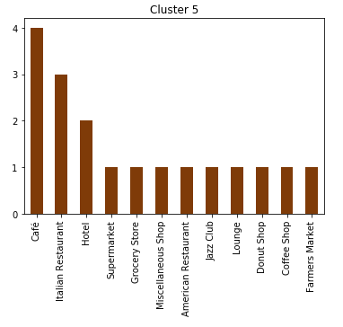
Category distribution for Cluster 5

Slide 13
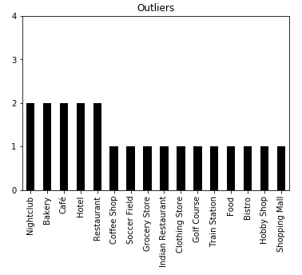
Category distribution for Outliers

Slide 14
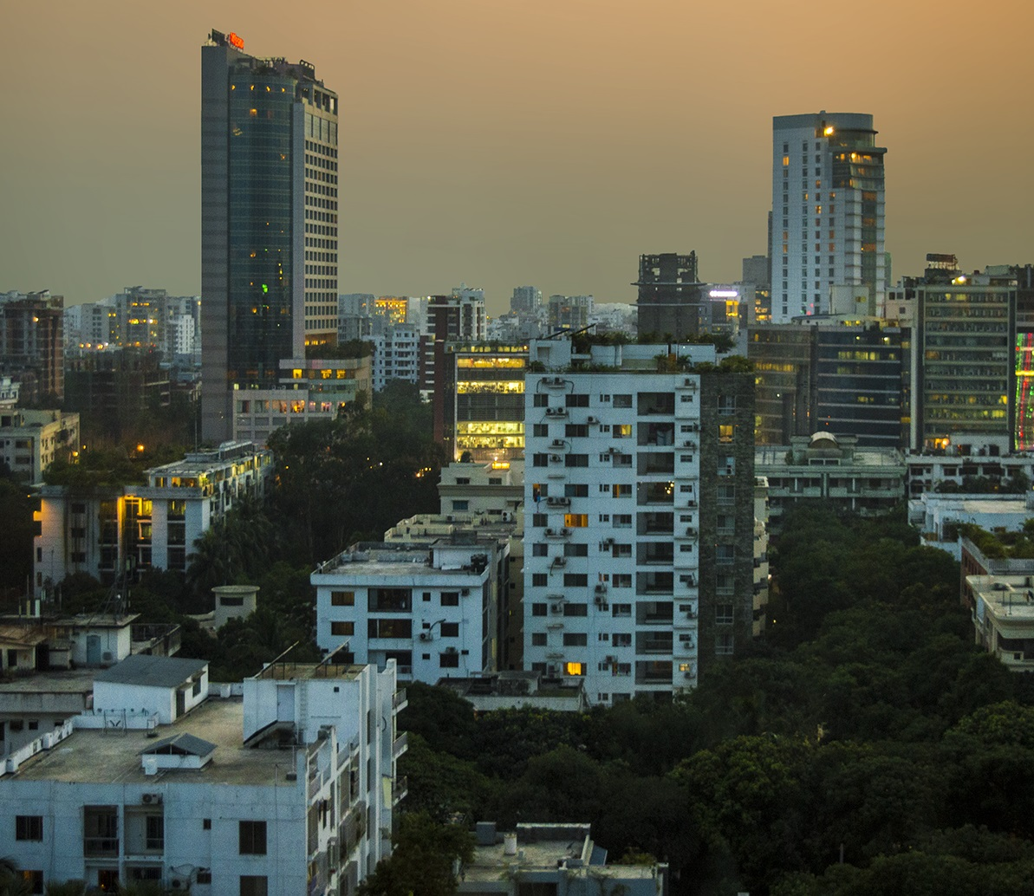
Findings
Among the 6 cluster, cluster 5 was the largest and more varied, while cluster 0 was the opposite. This indicates the fierce competition near the area of cluster 5 and the opposite around cluster 0.
This analysis will help the entrepreneurs determine which business to start.
Hopefully more data on Dhaka will be collected so that the clustering done here becomes more appropriate and more people are benefited from the analysis.

Slide 15
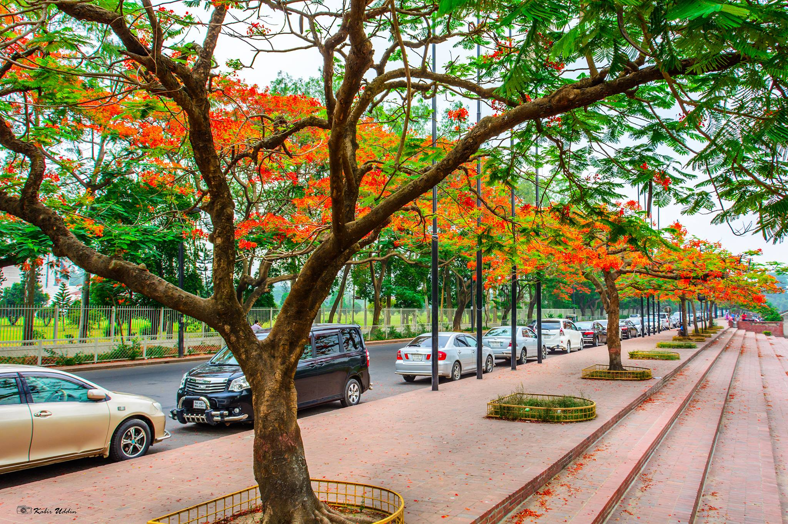
Thank you
Abidur.4.Rahman@gmail.com

